Slide 1
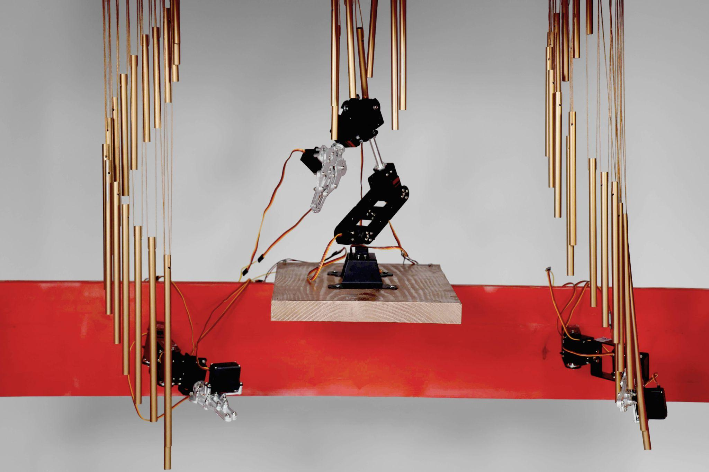

Slide 2
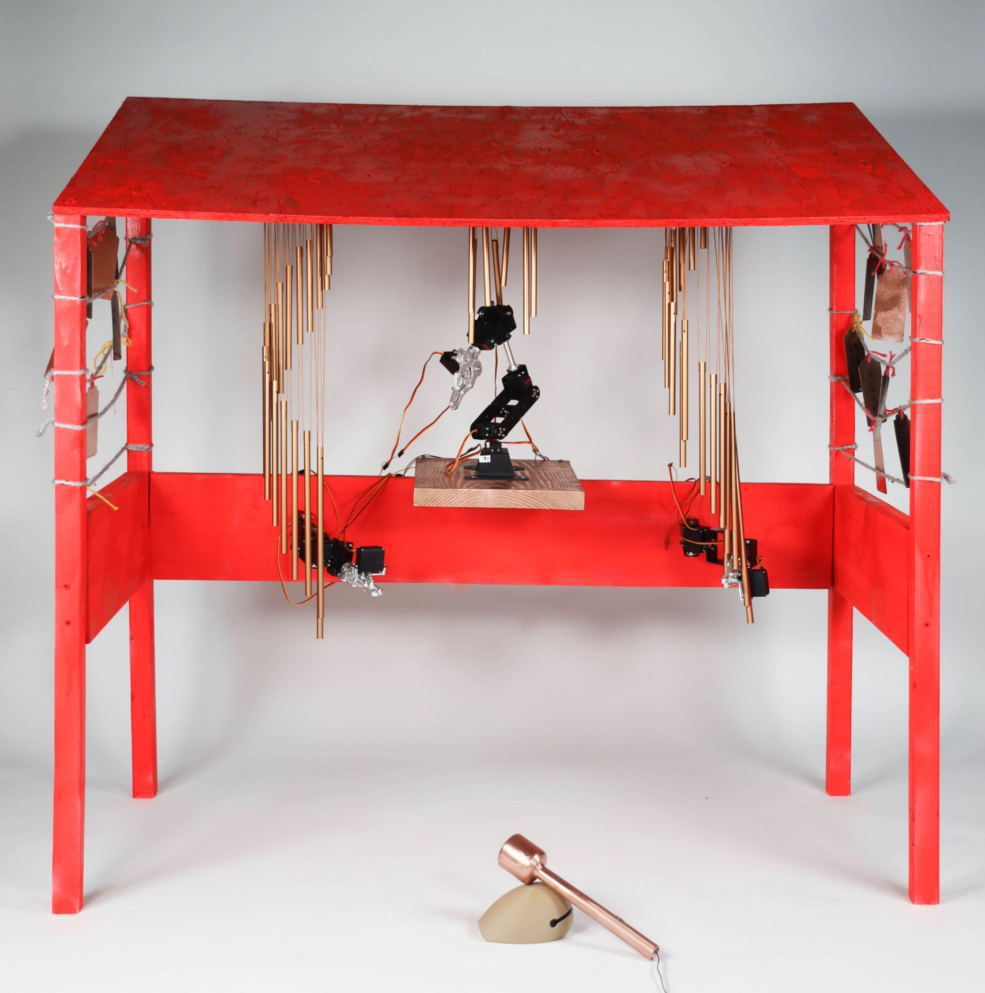
Chime of the
Hidden Pulse
Physical Interaction II
Diyu Zhou
Shuhan Liang (Kevin)
Wing Sze (Sissi) Zheng
Physical Interaction Project 3

Slide 3
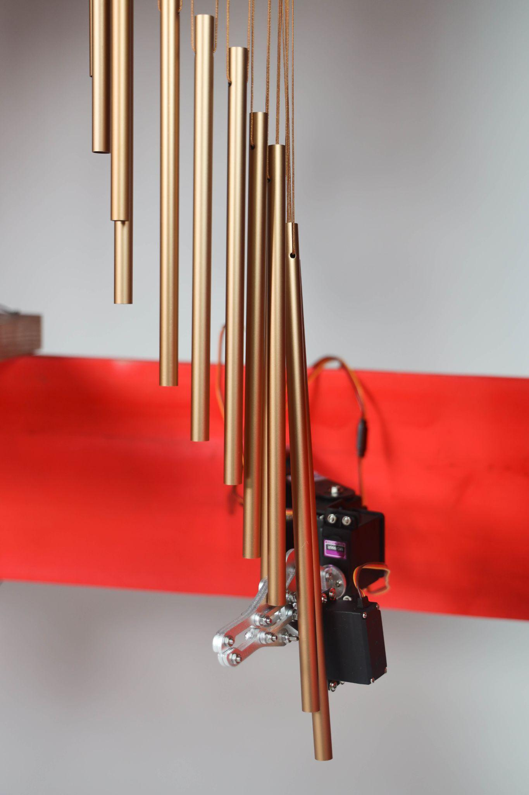
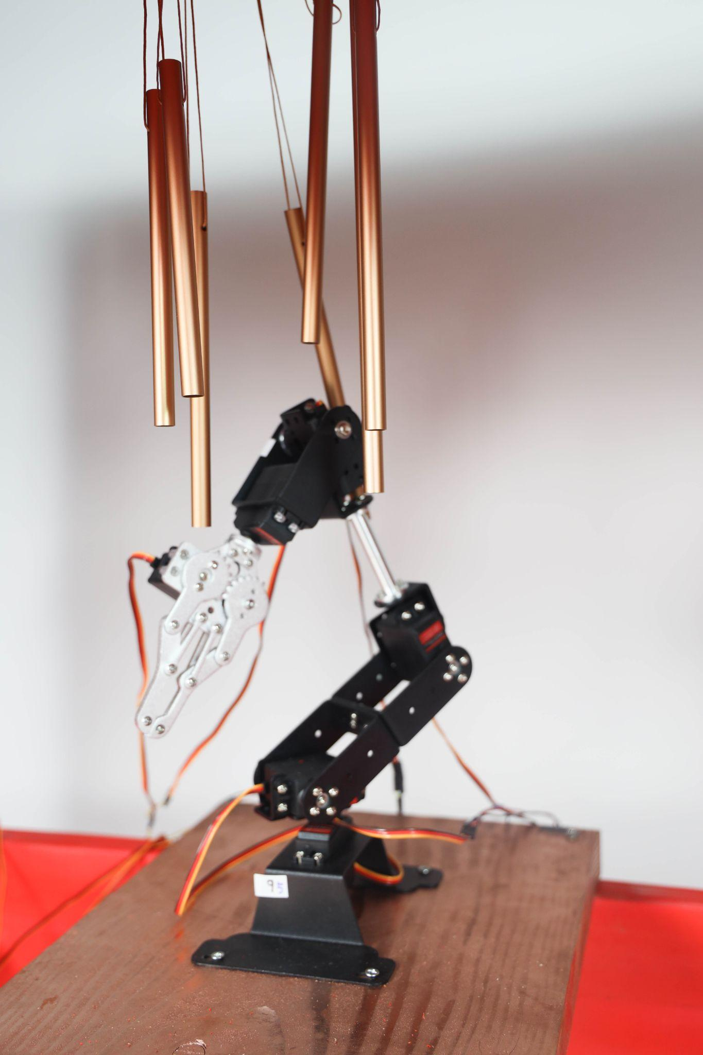
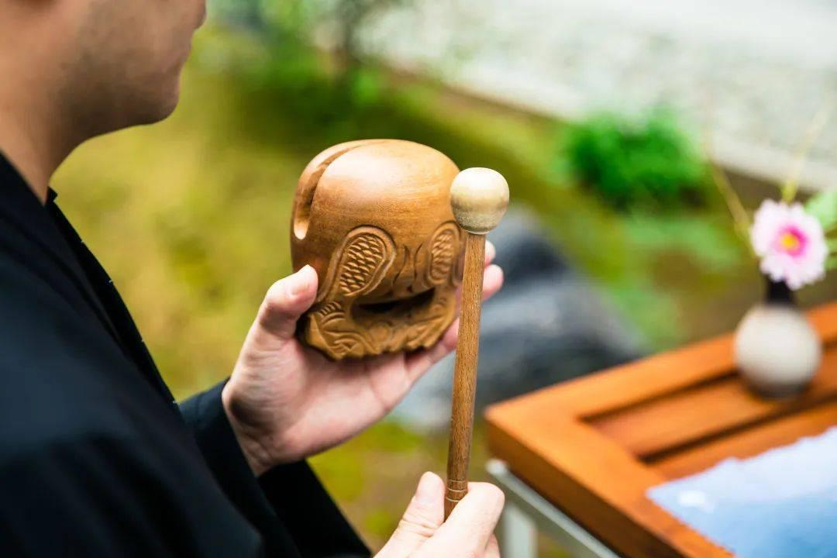
Inspiration
Technology
Tradition
Combining the traditional act of striking a wooden fish with modern technology, this work makes the invisible inner world visible through mechanical arms and wind chimes.
Physical Interaction Project 3

Slide 4
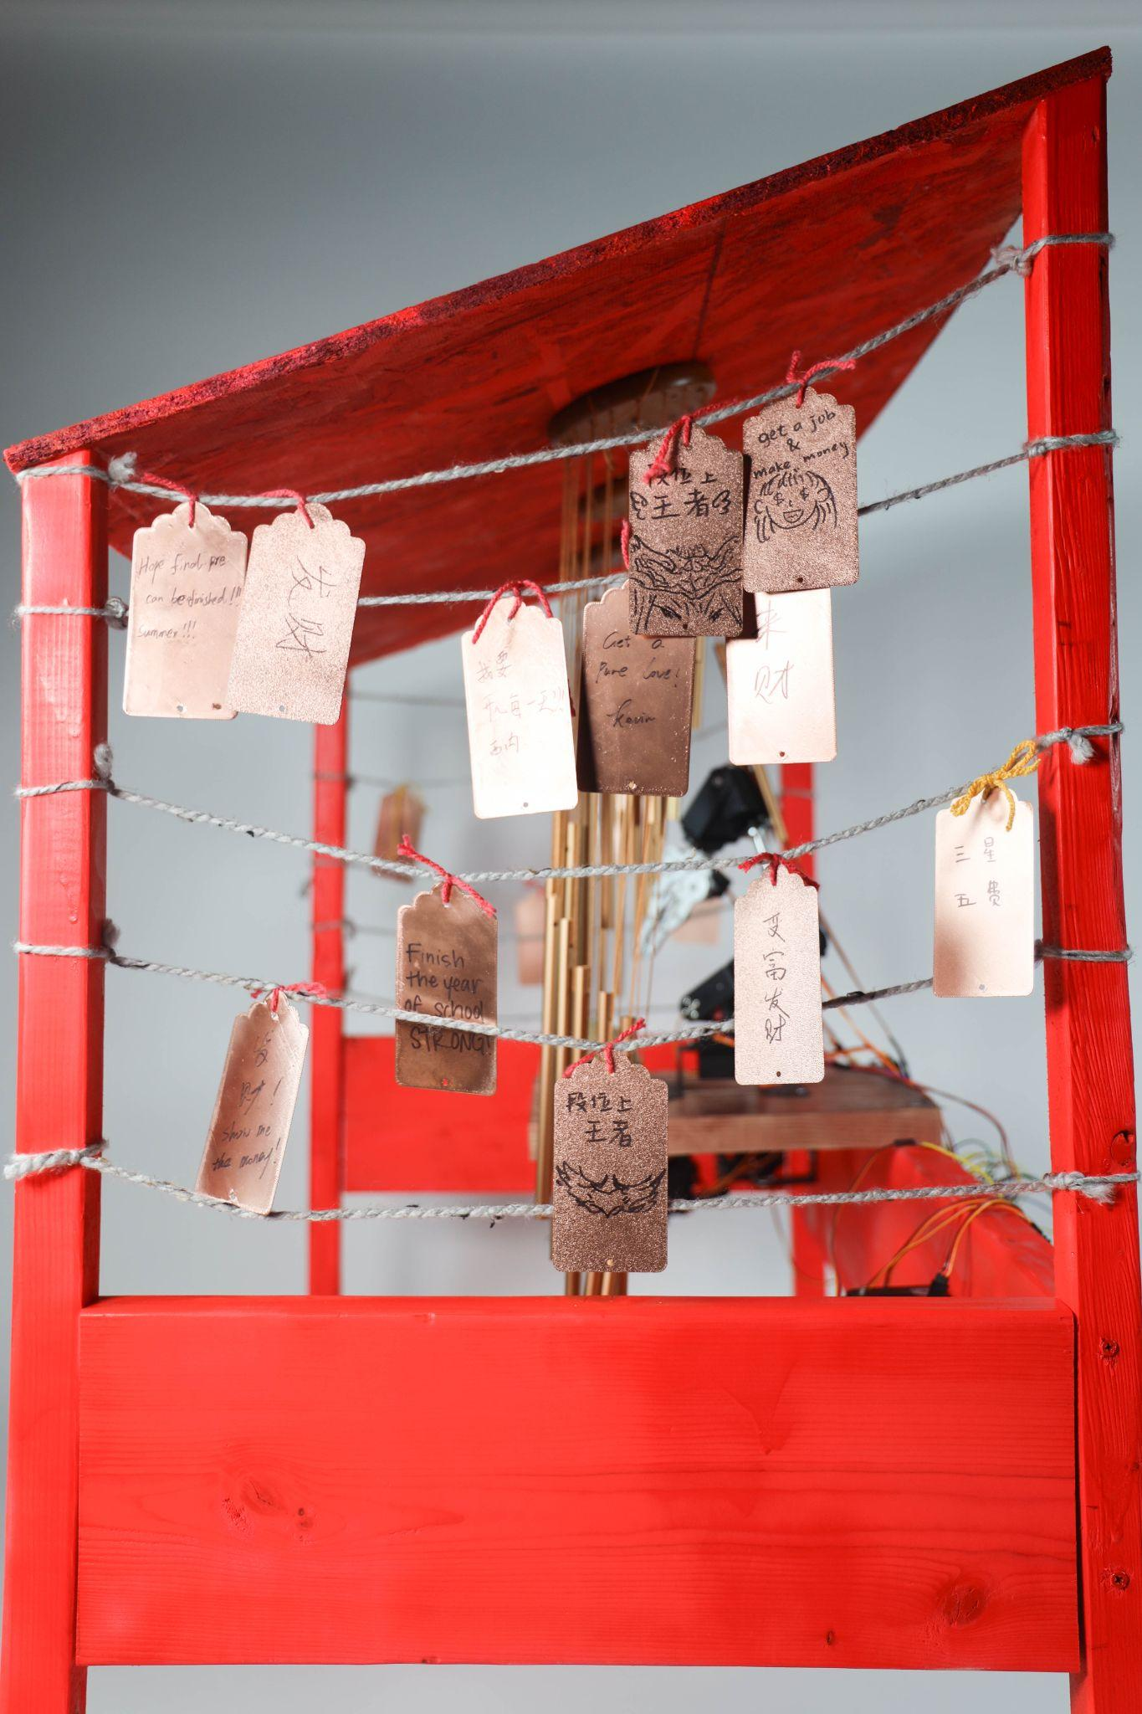
Concept
Why Robotic Arm?
In religious activities, striking the wooden fish is a rhythmic and contemplative gesture. We chose a robotic arm to respond to the user's striking motion, preserving the formal quality of the "ritualistic act" while also highlighting the interactive logic between human and machine through mechanical movement. The robotic arm symbolizes a modern technological reinterpretation of traditional ritual—serving as a mediator that connects human action with the underlying “divine” sound.
Why Wind Chime?
The sound of wind chimes is spiritual and ever-changing, possessing a natural, nonverbal capacity for emotional expression. Through their resonant rhythms, we transform cold heart rate data into a sensuous auditory experience. Unlike musical instruments, wind chimes are not precisely controllable—they sound only when moved by the wind. Just like a heartbeat, they are involuntary yet perceptible and amplifiable. By leveraging the “naturalness” of wind chimes, we imbue physiological signals with a sense of ritual.
Why Heart Pulse?
The heartbeat is the most direct and emotionally charged physiological signal. It truthfully reflects a person's mental state—whether tense, calm, excited, or sad—serving as a mirror of both emotion and life. On a technical level, heart rate can be measured with precision; on a spiritual level, it symbolizes the “movement of the heart.” This dual nature makes it an ideal medium. In this project, heartbeat data becomes the core of sonic expression, forming a closed loop of internal perception → external expression → environmental resonance.

Slide 5
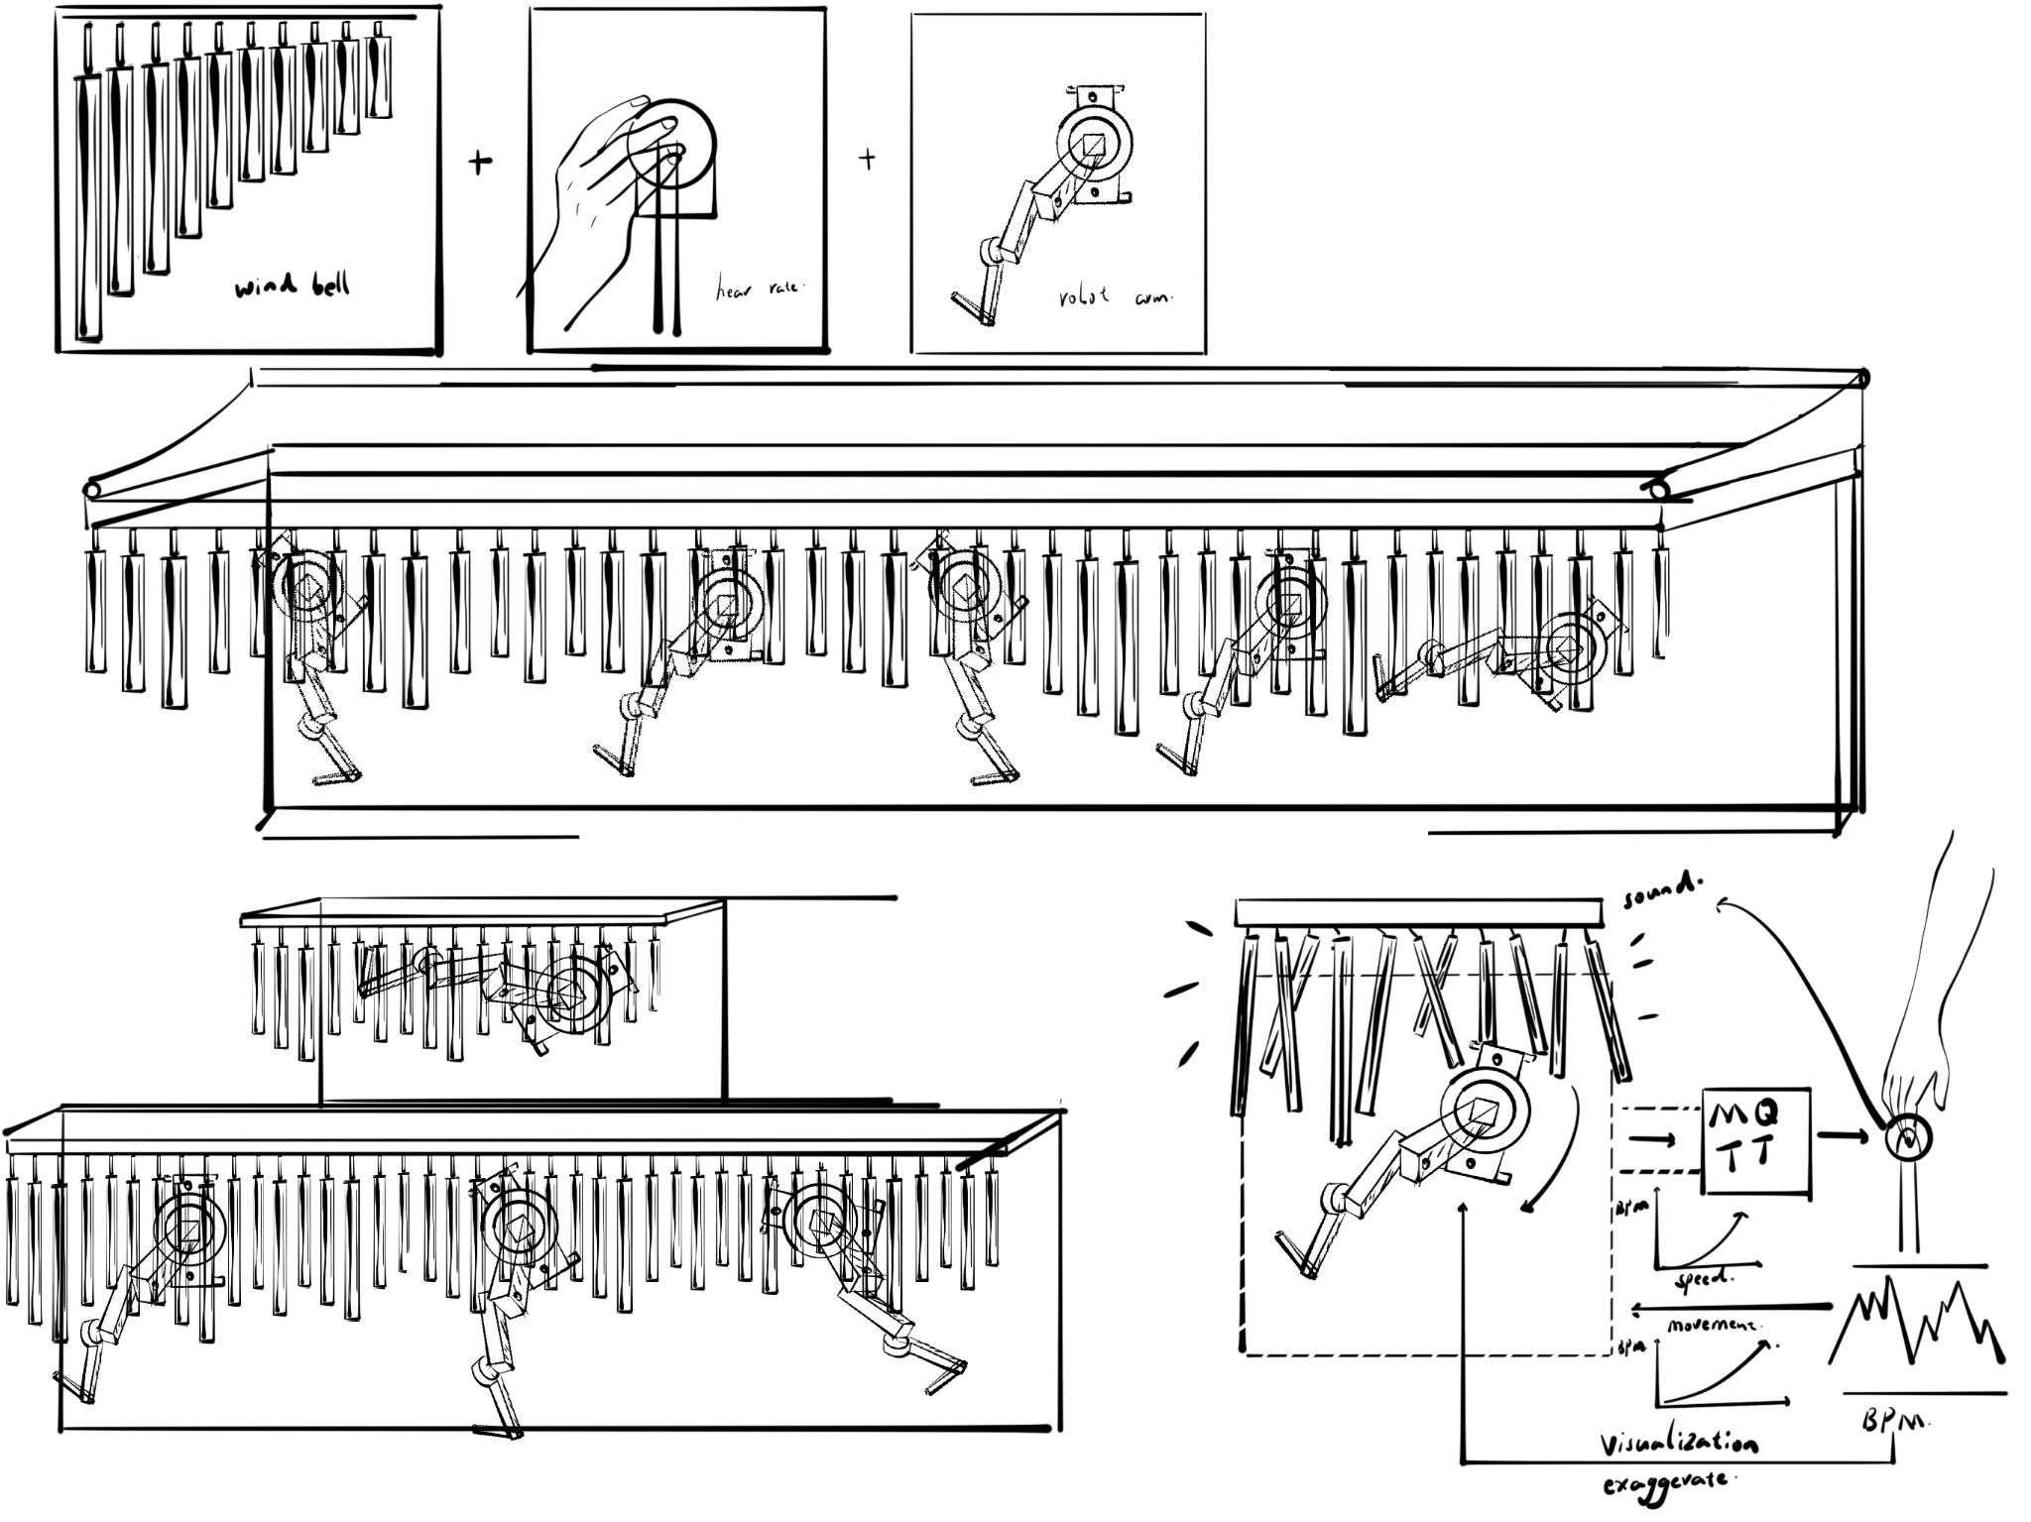
sketch

Slide 6
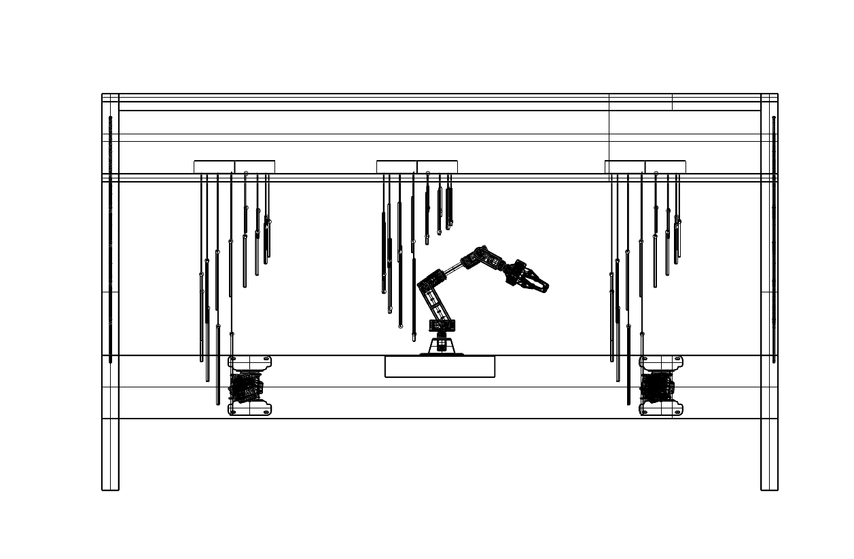
Model Design

Slide 7
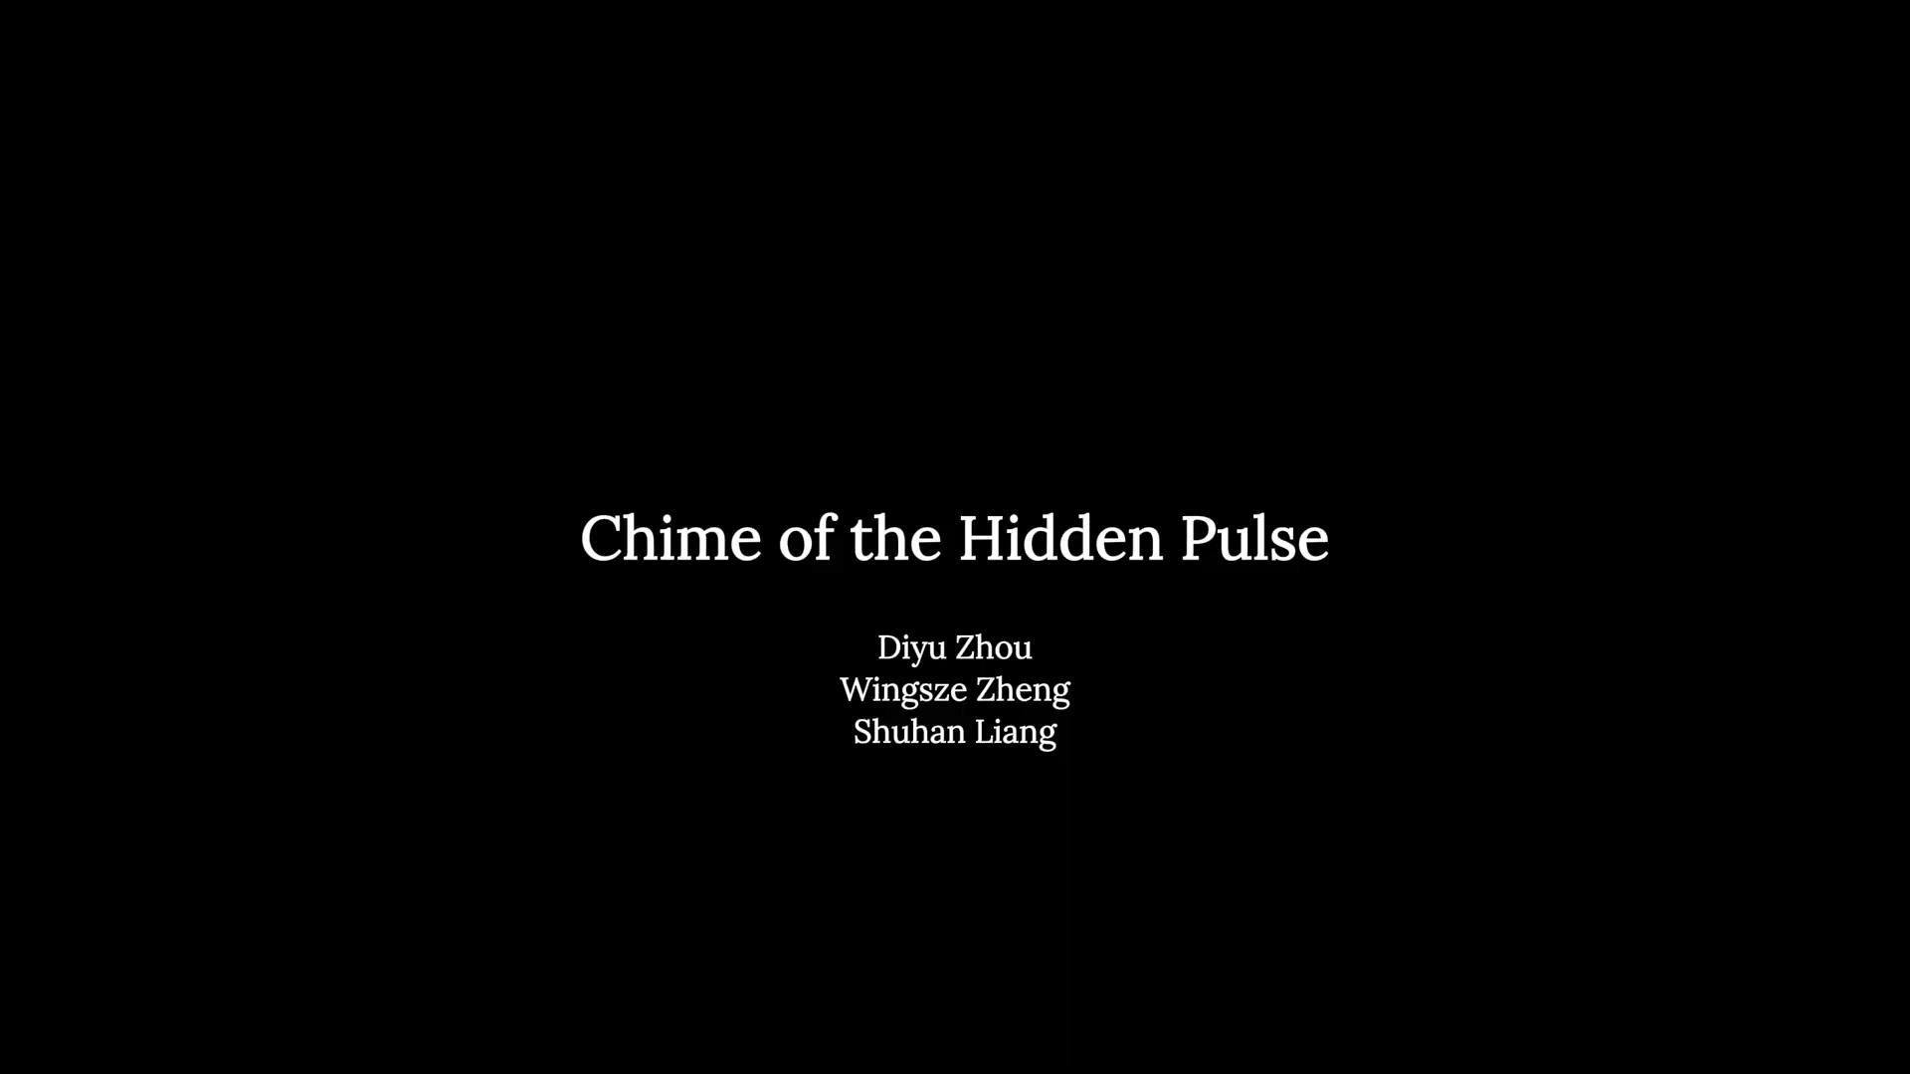

Slide 8
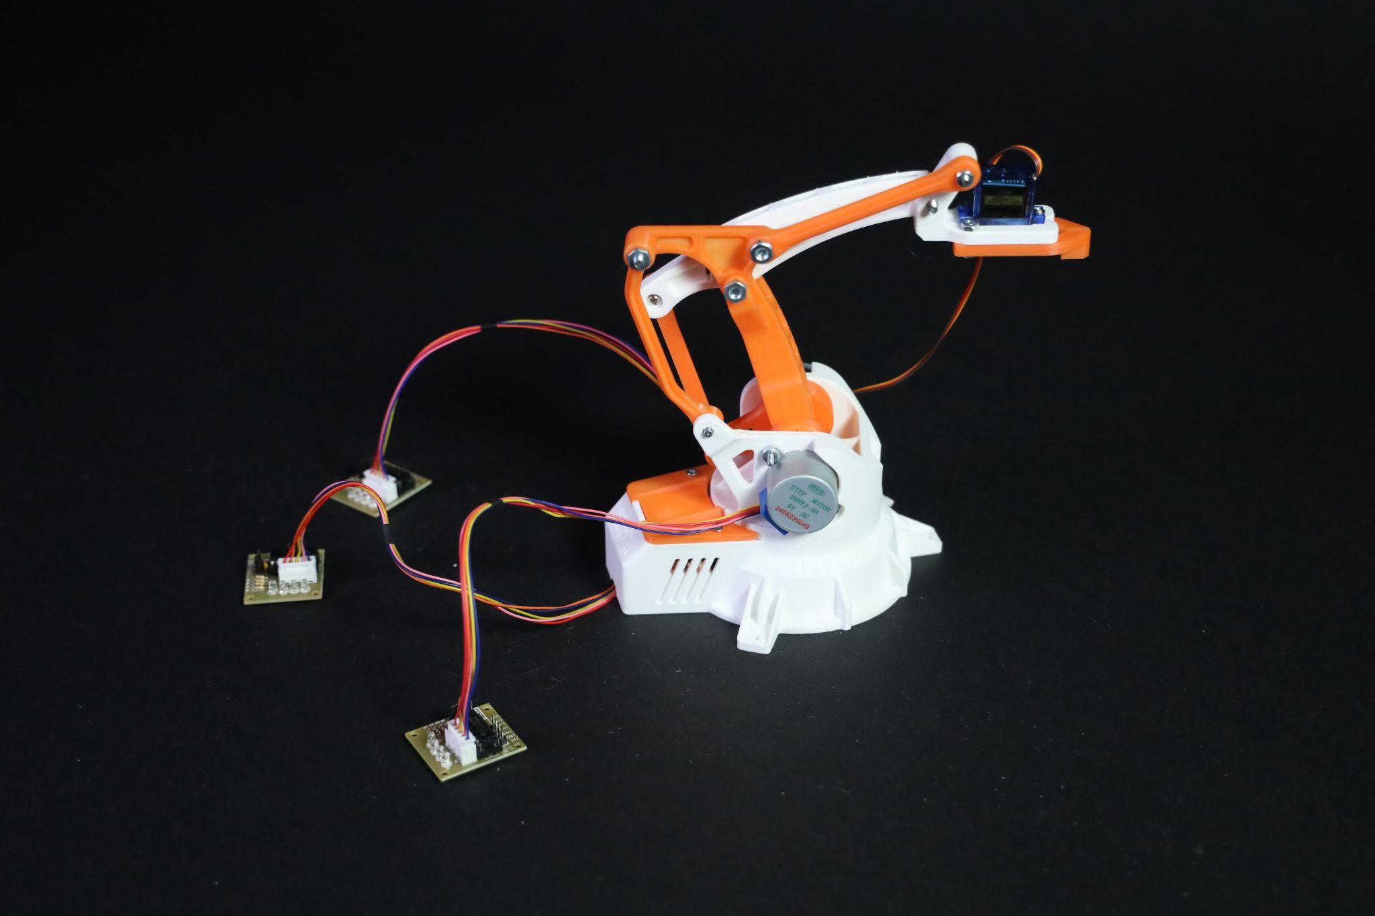
Prototype

Slide 9
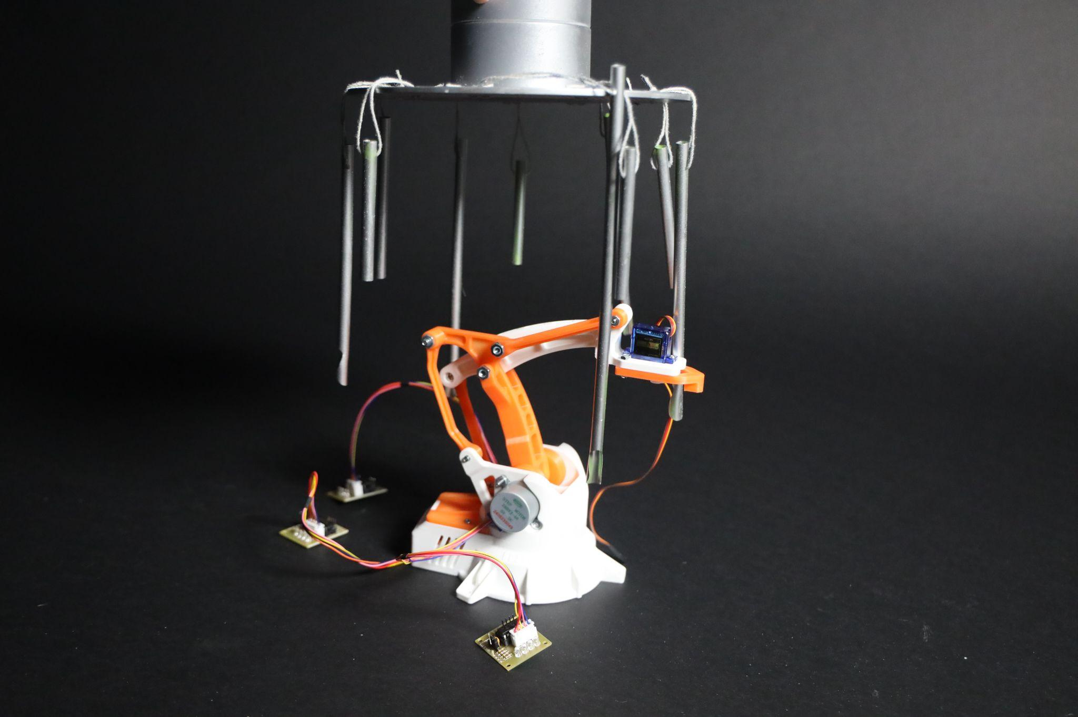
Wind Chime
Robotic Arm
Prototype

Slide 10
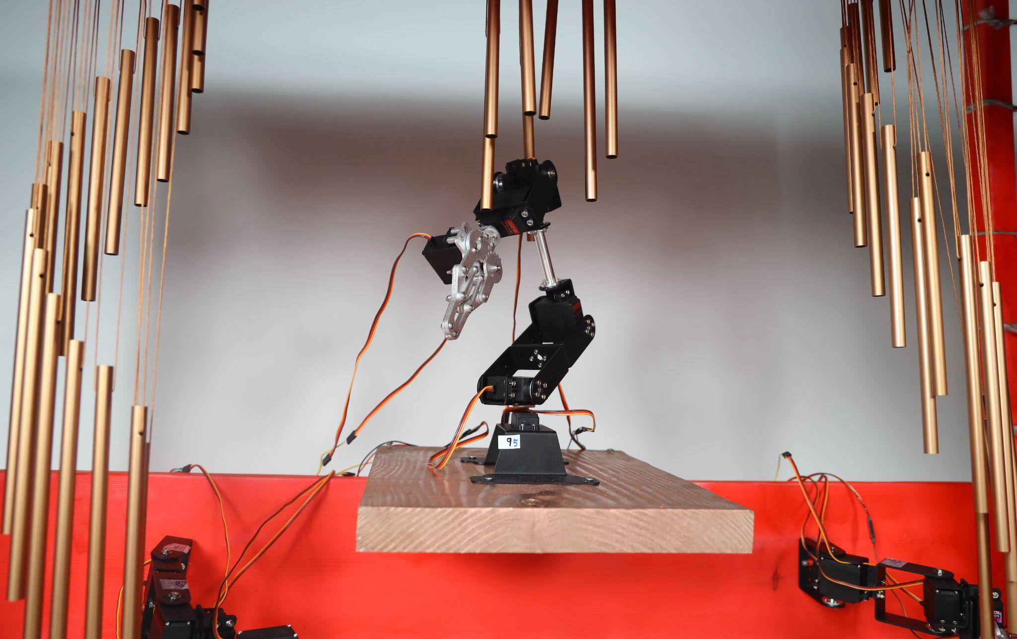
Final Model

Slide 11
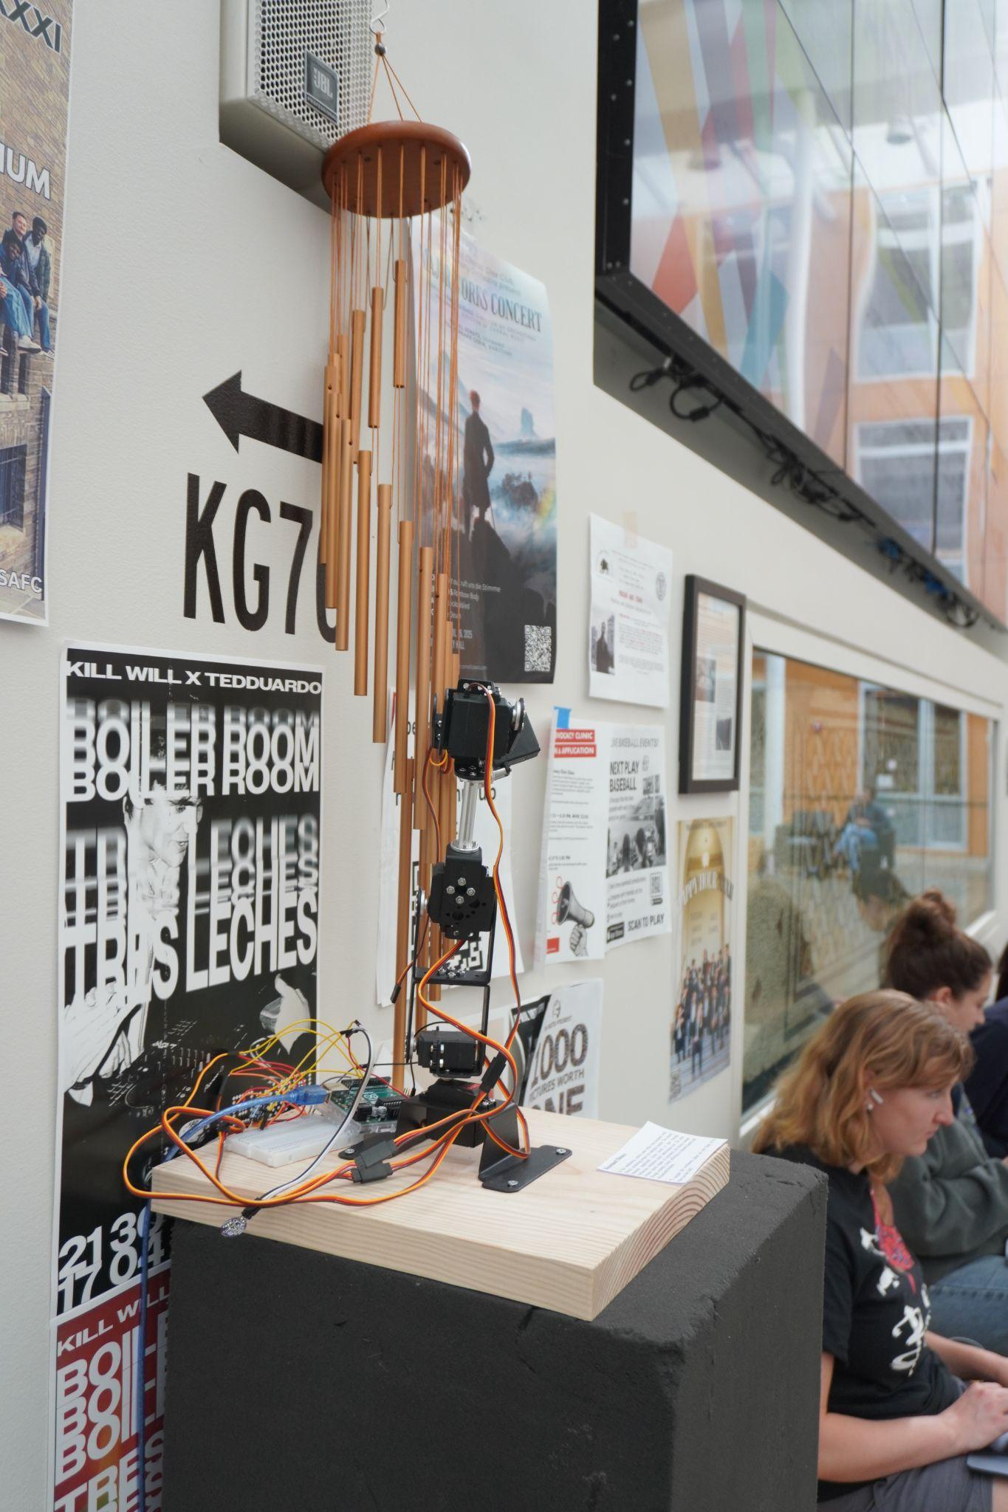
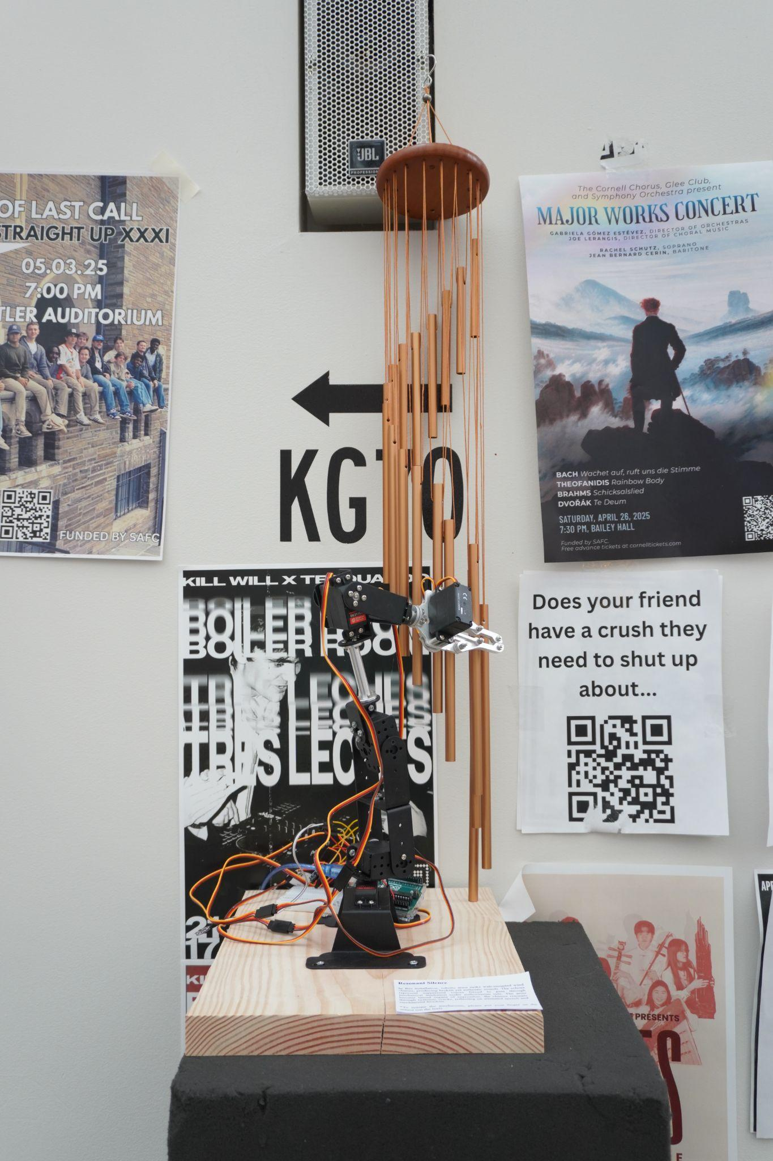
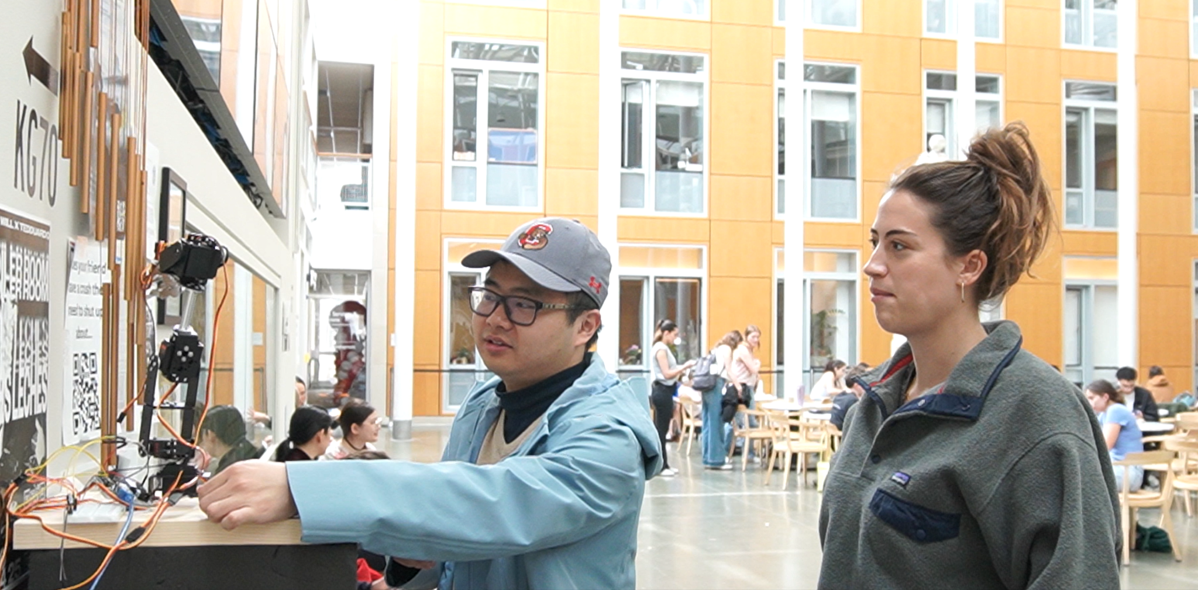
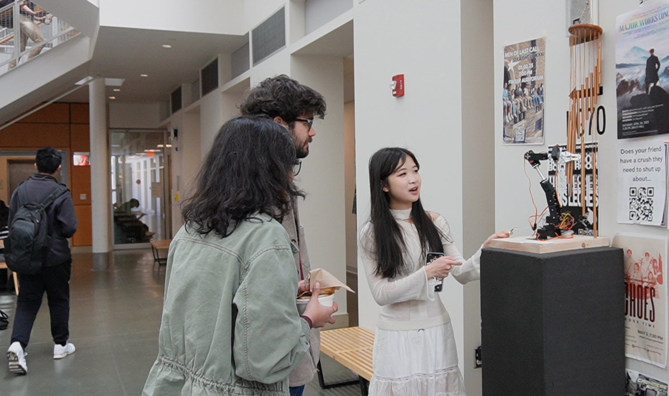
Initial Simulation
Test the mechanism and reactions of viewer

Slide 12
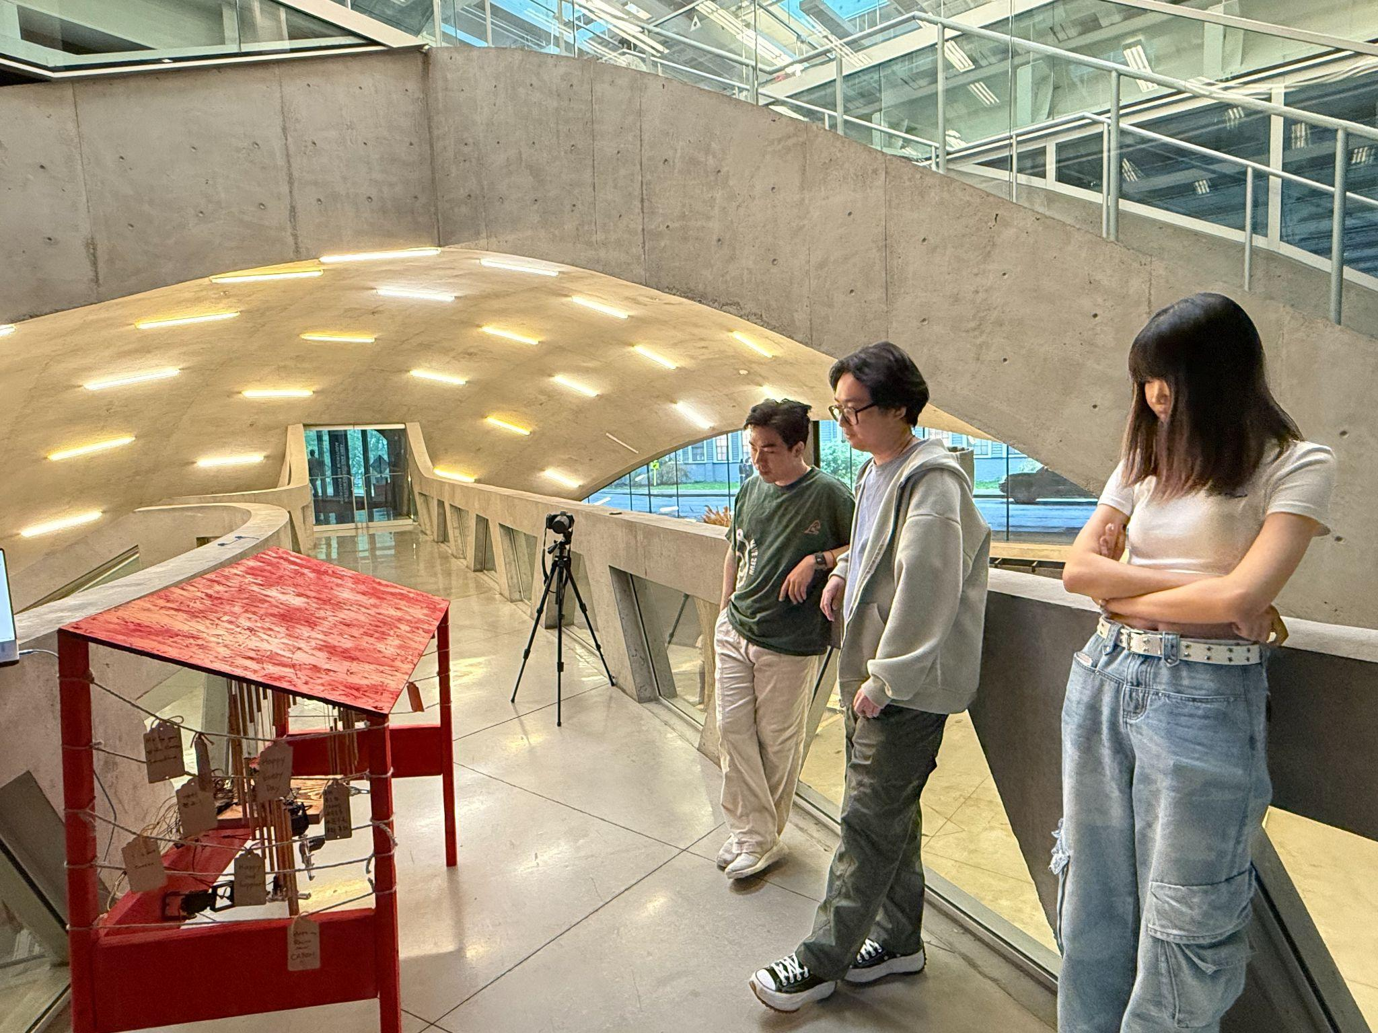
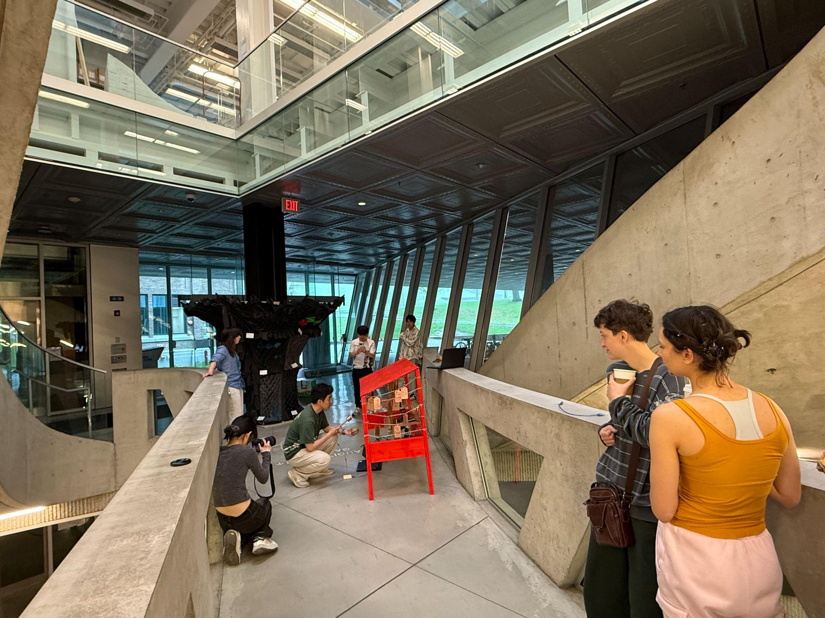
Site
Entrance of Milstein Hall: (1)In front of Auditorium and AAP Gallery , it is the convergence of secular and non-secular spaces; (2) A large circulation of people to interact with.

Slide 13
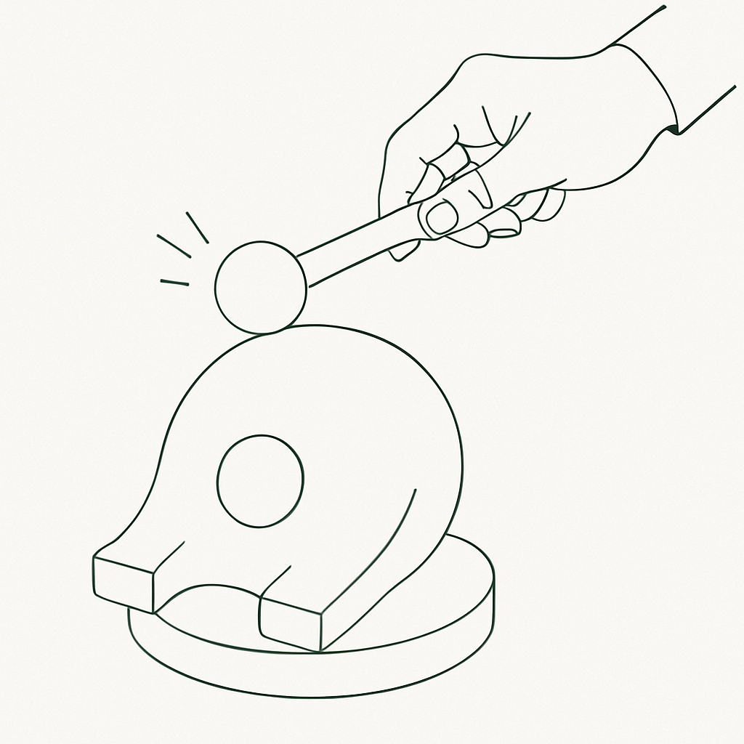
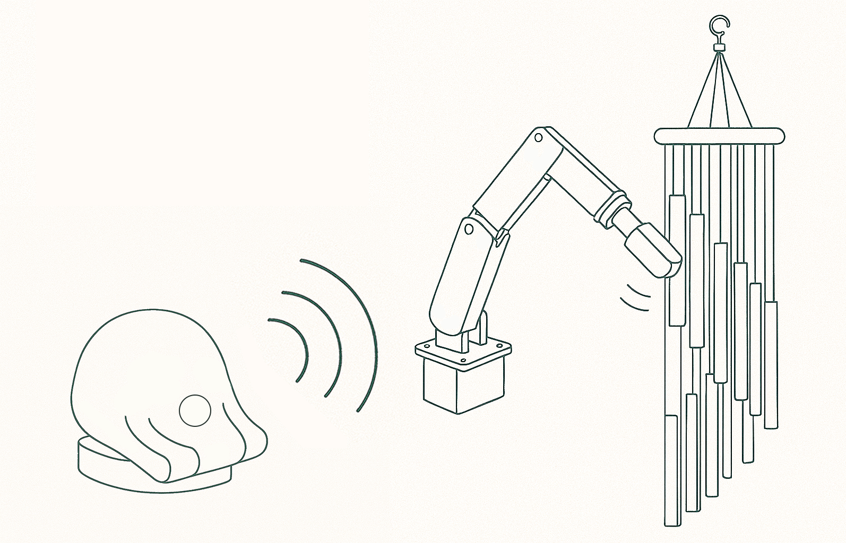
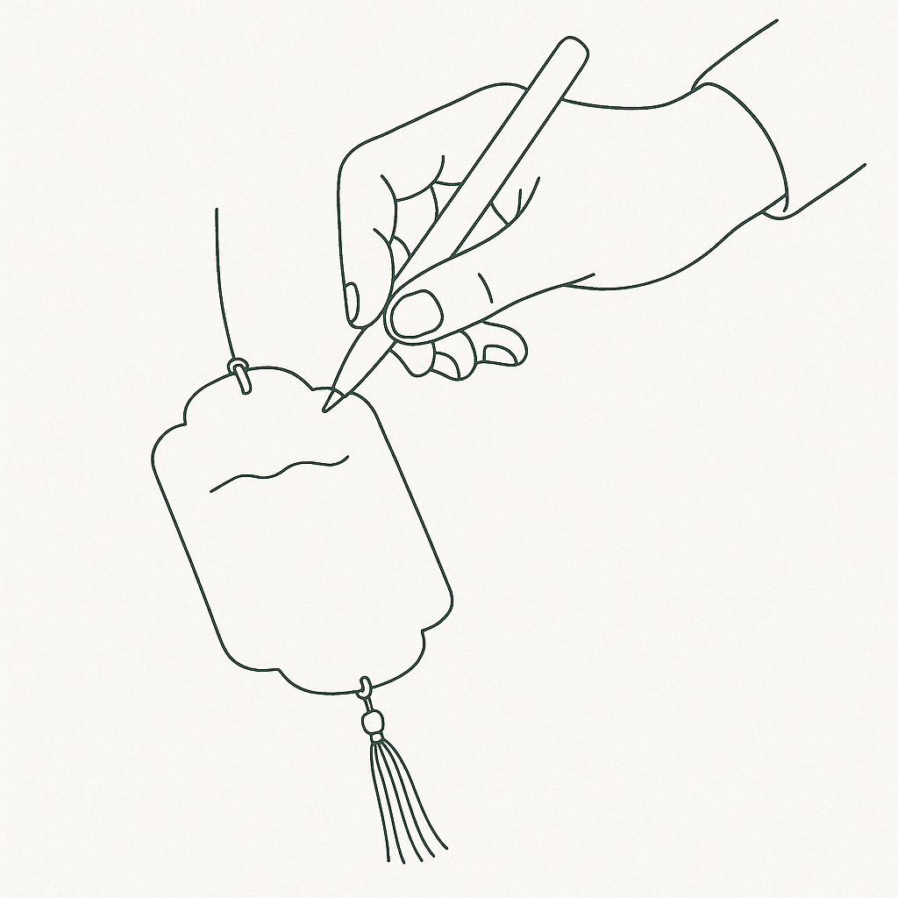
Storyline
… invites participants on a journey of mindfulness and self-reflection through interactive rituals
Knocking the Wooden Fish:
(Heart Pulse Sensor Detecting)
Heart Pulse reflected on the sound of wind chimes
Mindfulness Reflection
(Make a wish or ask for a fortune)
Notes:
牌子+木鱼概念

Slide 14
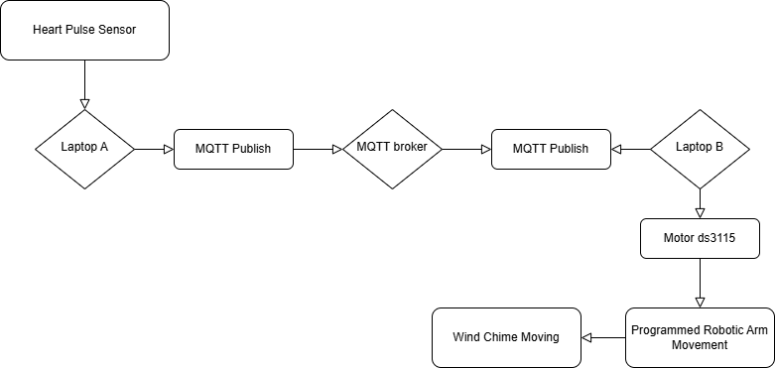
MQTT Workflow
Bpm data string
Subscribe

Slide 15
Programmed Robotic Action
BMP
Effect
Stroke
< 60 | 10 Seconds: Very slow, soft strokes, like a gentle breeze | Slight single axis tapping (such as Z-axis up and down)
60 ~ 70 | 8 Seconds: Gradually quickening rhythm | Multi axis coordinated motion (such as XY+Z stretching strike)
> 70 | 5 Seconds: Strong, short, and intense beats | Quickly swing and add a rotating axis (such as XYZ+Roll)
Main Arm:
3 Programmed Level Movement: Strong, Middle, Soft
Small Arm 1: Fixed Movement
Small Arm 2: Fixed Movement

Slide 16
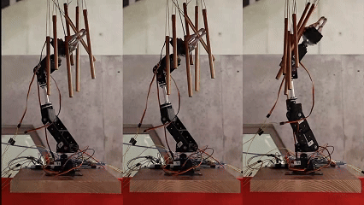
Programmed Robotic Action
Phrase 2: Normal
8 Seconds: Gradually quickening rhythm | Multi axis coordinated motion XY+Z stretching strike
transitionSmooth = 0.05;
amp1 = 60, amp2 = 0, amp3 = 50, amp4 = 20;

Slide 17
Programmed Robotic Action
Phrase 1: Slow
10 Seconds: Very slow, Soft strokes, like a gentle breeze | Slight single axis tapping Z-axis up and down
transitionSmooth = 0.03;
amp1 = 70, amp2 = 30, amp3 = 20, amp4 = 50;

Slide 18
Programmed Robotic Action
Phrase 3: Fast
5 Seconds: Strong, short, and intense beats | Quickly swing and add a rotating axis XYZ+Roll
transitionSmooth = 0.01;
amp1 = 50, amp2 = 40, amp3 = 50, amp4 = 40;

Slide 19
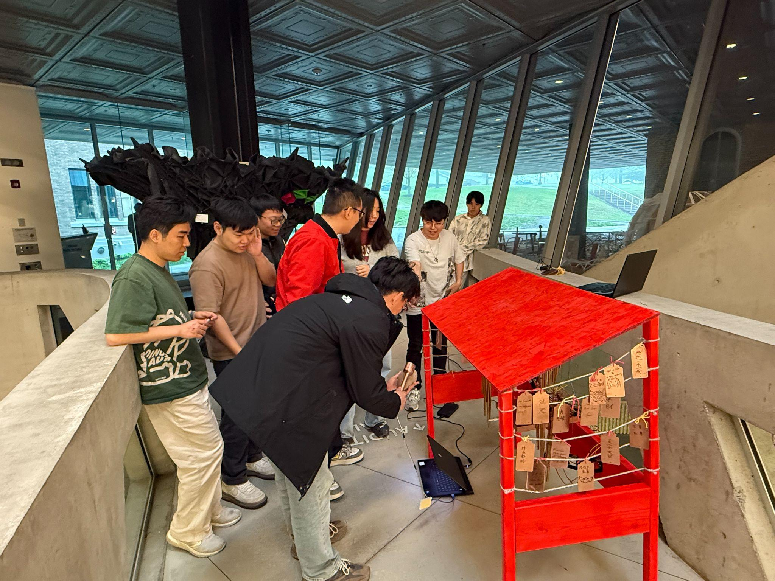

Slide 20
What We Learnt
Interdisciplinary Integration: How to combine traditional rituals (wooden fish, prayer) with modern physical computing and robotics.
Sensor-Driven Interaction: Using biometric data (heart rate) to generate responsive motion and sound.
Collaborative Workflow: Learned how to divide tasks efficiently within a multidisciplinary team (coding, prototyping, design, storytelling).
User Empathy: How to design experiences that evoke emotional and spiritual resonance in public spaces.

Slide 21
Limitation & Further Exploration
Limitations
Wind chime placement is sensitive to environment noise and airflow.
Robotic movements could be smoother and more fluid.
Future Exploration
Multisensory Enhancement: Integrate scent, light, or projection for a fuller immersive experience.
Expanded Ritual Logic: Include more bodily sensors or cultural gestures (e.g. bowing, incense lighting) as input.

